Slide 1
ILEE - General Annual Meeting
Report 2019/Outlook 2020
Tuesday, 11 February 2020
La Bourse, Place d’Armes 1, Namur

Slide 2
Members
Report for 2019
105 (107) researchers, with 18 (21) academics
14 technical & administrative staff (affiliated to ILEE)
Large variety of disciplines: Biology (57), Geology (16), Geography (13), History/PolleN (7), Physics (4), Chemistry(4), Art History and Archaeology (2), Law (1).
~2/3 affiliated 100% to ILEE. Other institutes: Narilis, naXys, Trans, NISM, PaTHs, Esphin
Please introduce new colleagues → email to carolin.mayer@unamur.be (photo & short description for the Newsletter)
© F. Silvestre
Notes:
Not very much has changed in terms of figures: Numbers in brackets are for 2018; 3 academics affiliated at 50% in 2018 left to their other research institute (JY Matroule with 3 students, G Terwagne with 1 student, D Van Dam)

Slide 3
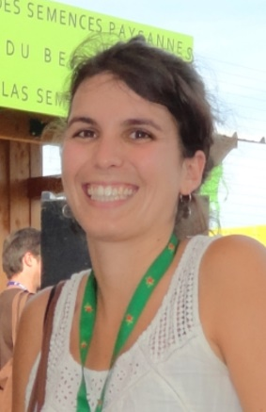
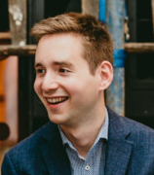
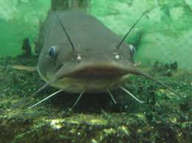
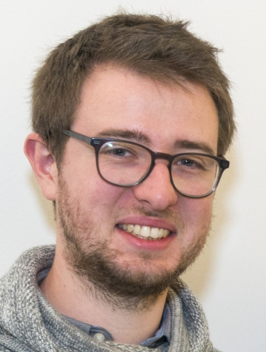
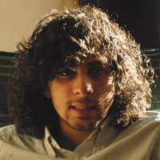
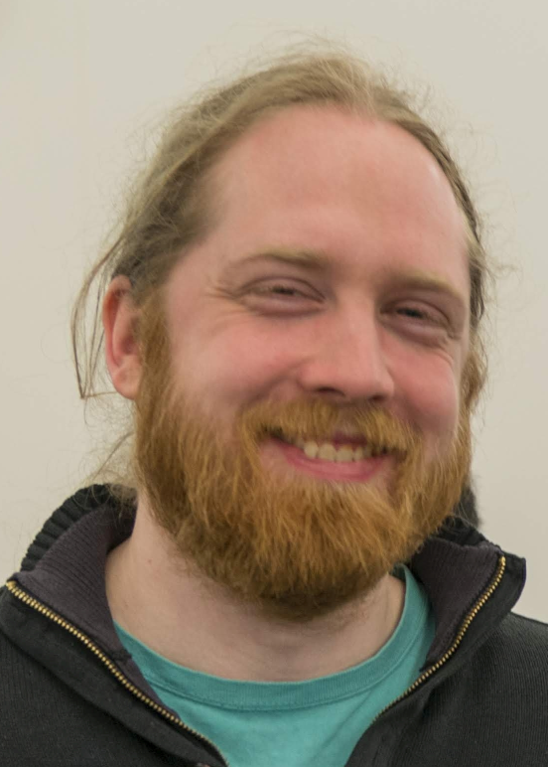
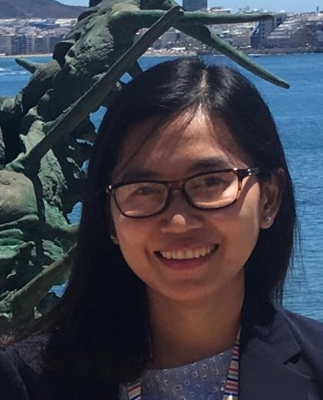
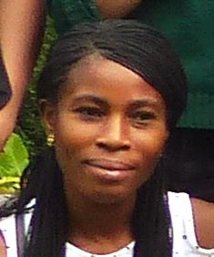
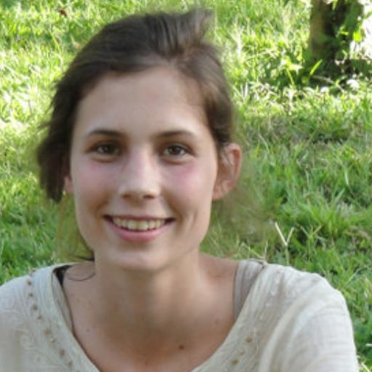
PhD outcome
Report for 2019
9 Theses defended
Sofia COSTA SANTOS BALTAZAR (Geography)
Jonathan DE RAEDT (Biology)
Aboubacar SOURABIE (Biology)
Augustin DECKONINK (Geology)
Emmanuel TINTI (Chemistry)
Sylvain LEONIS (Physics)
Nicresse GUEDEGBA (Biology)
TRUONG Quynh Nhu (Biology)
Lola RICHELLE (Geography)
© F. Silvestre
Notes:
2018: 10 theses defended

Slide 4
Publications
Report for 2019
66 articles/book chapters published
Article metrics: cited ø 0.9 x (January 2020), may seem few, but papers from 2018 have now been cited ø 4.05!
All publications with full text links can be found on the website
Do not forget to mention ILEE in your affiliation details at publishers!
Remember to attach your publications to ILEE in PURE! (in the “keywords” section, possible for >1 institute)
Or even easier: Send your publications (or the link) to Carolin → for the newsletter and she can introduce it into PURE ☺
© F. Silvestre

Slide 5
Projects
Report for 2019
33 projects already running
9 launched during 2019
Funding sources:
As for publications: Attach your projects to ILEE in PURE or send the information to Carolin
© F. Silvestre
Notes:
2018: 49 projects; 5 projects in 2018 were run by the academics that left ILEE

Slide 6
Budget
Report for 2019
Receipts
Balance 2018 |  | 106.270,44 €
Received in 2019 | Annual fee & N° of members | 46.362,50 €
 | Theses & projects | 16.500,00 €
Subtotal |  | 169.132,94 €
Expenses
Staff | Scientific manager | 30.947,67 €
Third party deliveries | ALTERNET | 500,00 €
Hires & supplies | Sandwiches, flyer & other | 1.401,18 €
Research Day 2019 | Traiteur, prices, magician | 2.417,19 €
Teambuilding | Ferme Froidefontaine, bus | 1.388,99 €
Travel grant | 11 out of 15 are paid | 6.753,27 €
NARC expenses | Invited speakers | 430,70 €
Subtotal |  | 43.839,00 €
Balance to be carried over |  | 125.293,94 €

Slide 7
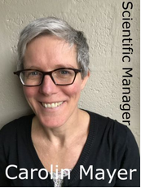
Activities in 2019
Report for 2019
8 Newsletters (1/month since September)
9 regular ILEE Lunch seminars (1/month, 1st Tuesday, next 3.3.)
2 seminars with invited speakers
2 seminars for FRIA candidates
ILEE Research Day in February (55 participants, 15 presentations)
Teambuilding Day in June (26 participants)
Travel Grant – 9 researchers funded (3 calls /y)
ILEE Happy Hour – 1 in December, next in March – looking for organisers!!!!!
Notes:
Next call for travel grant in march

Slide 8
Outlook 2020
New tasks for Scientific Manager:
English proofreading of manuscripts for publication/theses
Assistance with presentations (oral, poster,…) – seminar/workshop?
Help to create a bibliography
Advice with popularisation
Teambuilding Day: ~June? doodle will follow to find a date --- What?? Call for ideas
Travel Grant: next call mid-March
ILEE Research Day 2021: Where? What? Who? Ideas?

Slide 9
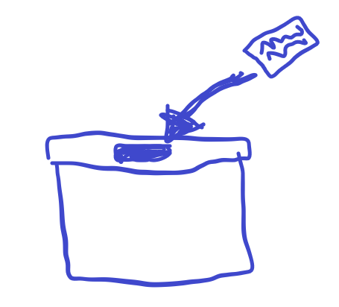
What do you want?
What activities are missing?
What is too much?
What is Ok but should change?
What does you retain from participating?
Can you identify with ILEE? Why? Why not?
Do you think ILEE is useful?
Do you have ideas for the functioning, working together, use of money…
Revise research topics?
→ Your ideas are welcome!
Write to ilee@unamur.be – Write it down NOW!

Slide 10
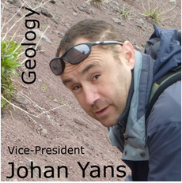
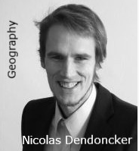
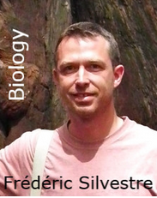
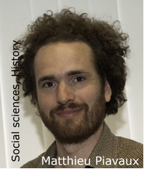
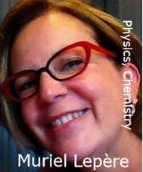
Steering committee – another 2-3 years!
Elected steering committee (2-3 y)
Meets 4x/y
Decides on events/grants/budget
Scientific orientation

Slide 11
Thank you!
ILEE - General Annual Meeting

